Slide 1
Product Management System
Product buy
Product Sale
Update Available product

Slide 2
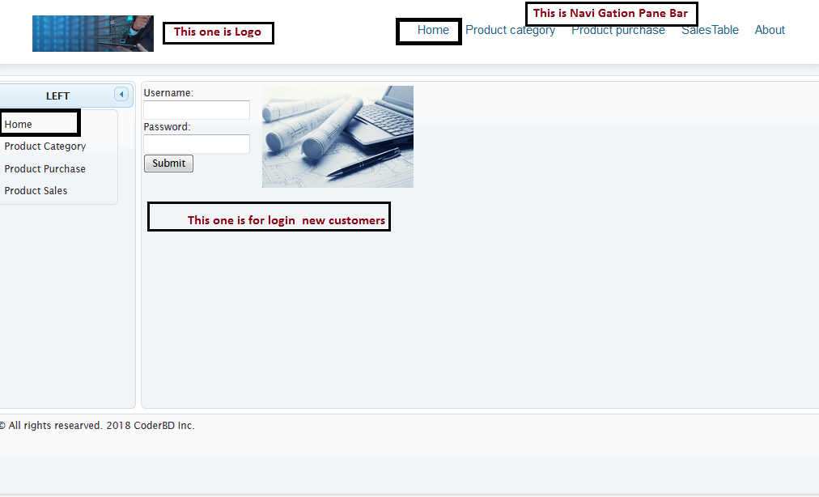
LogIn Page in Home Tab

Slide 3
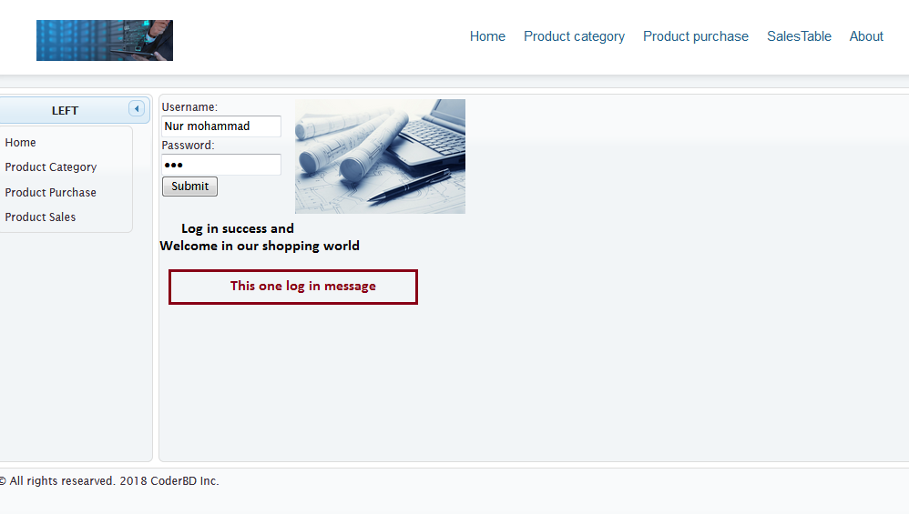
Login Success

Slide 4
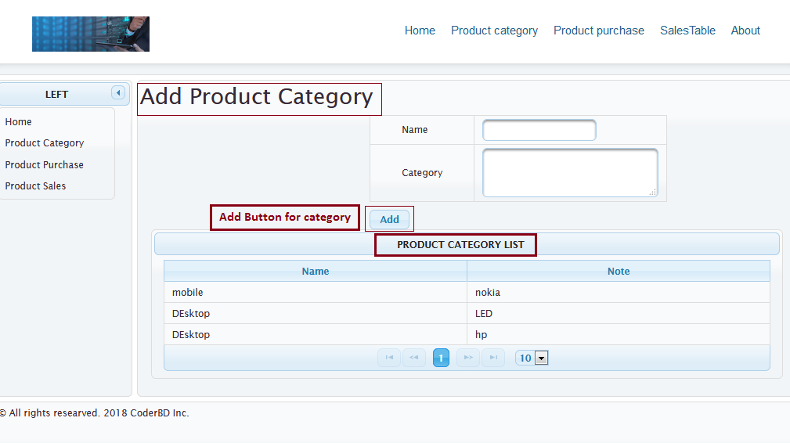
Insert Shop Available product

Slide 5
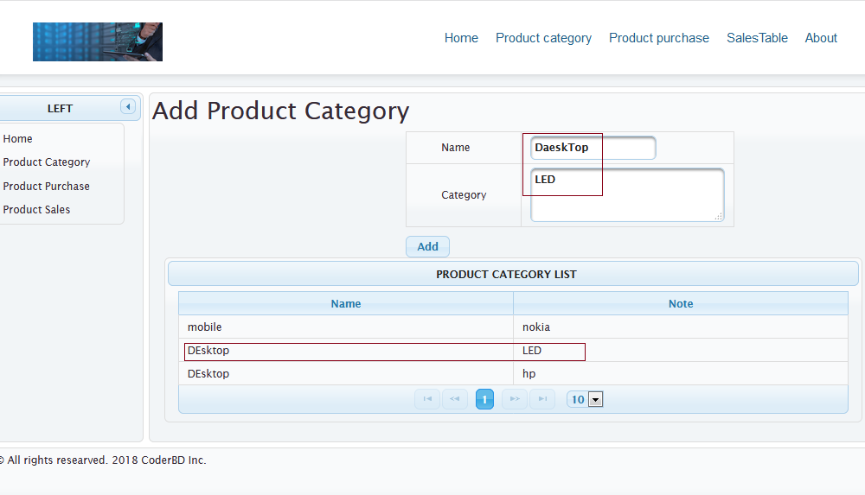
After Added product category

Slide 6
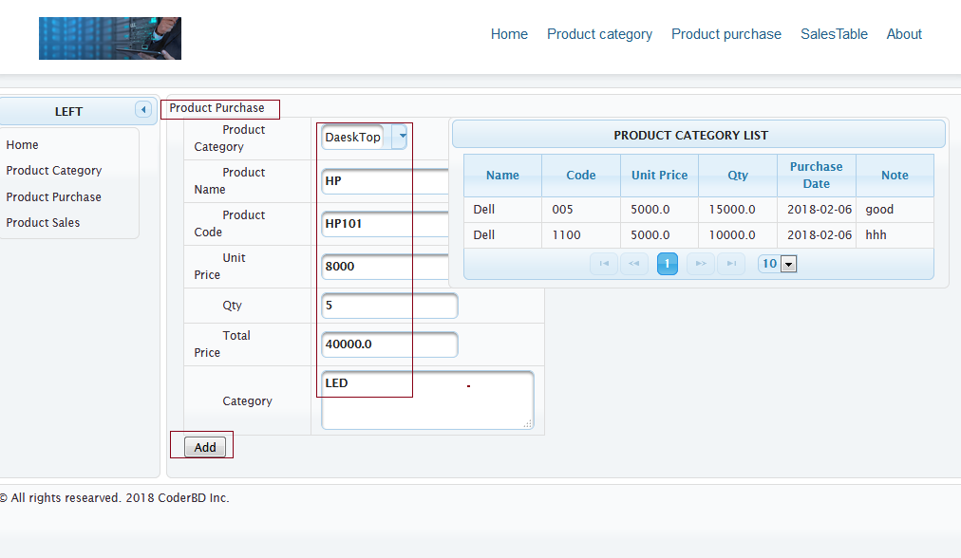
Customer ordered/purchase product

Slide 7
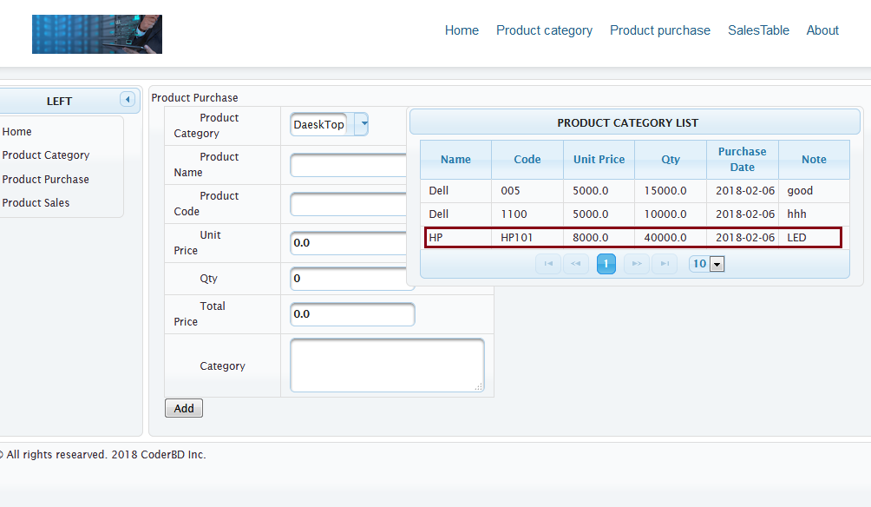
Product added on Order list

Slide 8
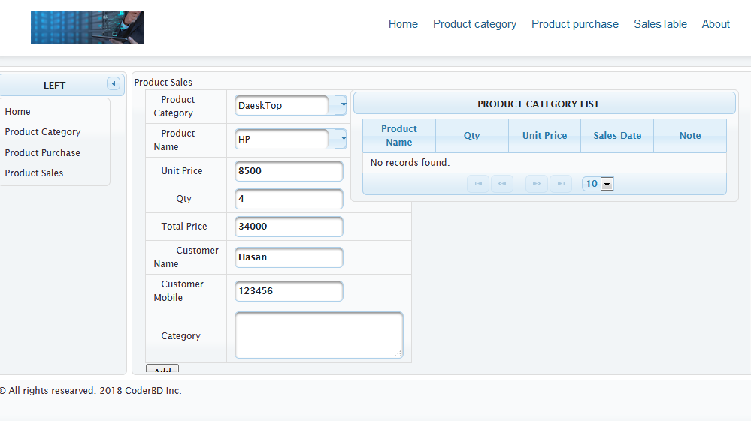
Sales Table Inserted

Slide 9
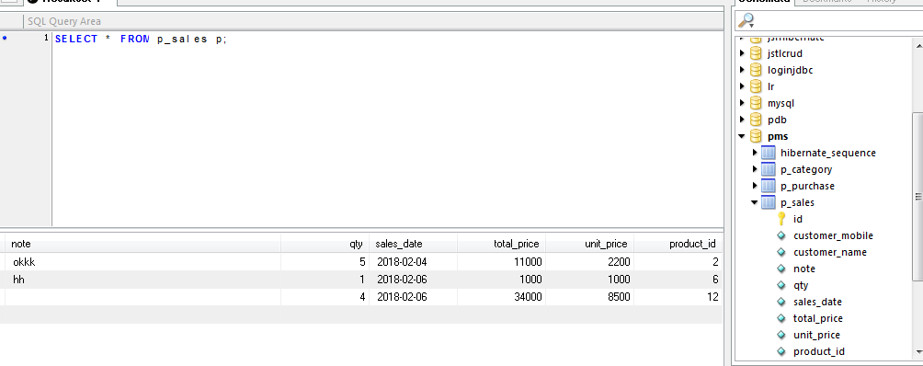
Salses Table Update

Slide 10
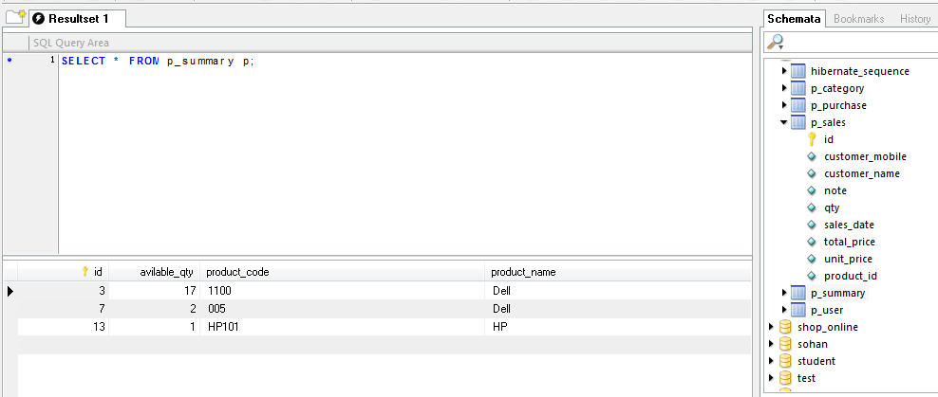
Available Quantity also Updated

